Slide 1
CS 2420: C++ Crash Courses
Dr. Tsung-Wei (TW) Huang
Department of Electrical and Computer Engineering
University of Utah, Salt Lake City, UT
Notes:
Hi everyone, thanks for giving me this opportunity to present Taskflow. This is a project motivated by parallelizing CAD and has gained quite a lot of success. I am going to present Taskflow works and hopefully we can brainstorm some collaboration topics.
Taskflow is a general-purpose parallel and heterogeneous task computing system.

Slide 2
Control Statements
All control statements are similar in all programming languages
if ( statement ) {
// ...
} else if ( statement ) {
// ... while ( statement ) {
} else { // ...
// ... }
}
for ( int i = 0; i < N; ++i ) {
// ...
do { }
// ...
} while ( statement );

Slide 3
Operators
Operators have similar functionality for built-in datatypes:
Assignment =
Arithmetic + - * / %
+= -= *= /= %=
Autoincrement ++
Autodecrement --
Logical && || !
Relational == != < <= >= >
Comments /* */
// to end of line
Bitwise & | ^ ~
&= |= ^=
Bit shifting << >>
<<= >>=

Slide 4
Arrays
Accessing arrays is similar:
const int ARRAY_CAPACITY = 10; // prevents reassignment
int array[ARRAY_CAPACITY];
array[0] = 1;
for ( int i = 1; i < ARRAY_CAPACITY; ++i ) {
array[i] = 2*array[i – 1] + 1;
}
Recall that arrays go from 0 to ARRAY_CAPACITY – 1
Definition:
The capacity of an array is the entries it can hold
The size of an array is the number of useful entries

Slide 5
Functions
Function calls are similar, however, the are not required to be part of a class:
#include <iostream>
using namespace std;
// A function with a global name
int sqr( int n ) {
return n*n;
}
int main() {
cout << "The square of 3 is " << sqr(3) << endl;
return 0;
}

Slide 6
C++/C# Differences
We will look at categories of differences between C++ and Java
Including header files (the preprocessor)
The file is the base of compilation
Namespaces
Printing

Slide 7
The C++ Preprocessor
C++ is based on C, which was written in the early 1970s
Any command starting with a # in the first column is not a C/C++ statement, but rather a preprocessor statement
The preprocessor performed very basic text-based (or lexical) substitutions
The output is sent to the compiler

Slide 8
The C++ Preprocessor
The sequence is:
file (filename.cpp) → preprocessor → compiler (g++)
Note, this is done automatically by the compiler: no additional steps are necessary
At the top of any C++ program, you will see one or more directives starting with a #, e.g.,
#include <iostream>

Slide 9
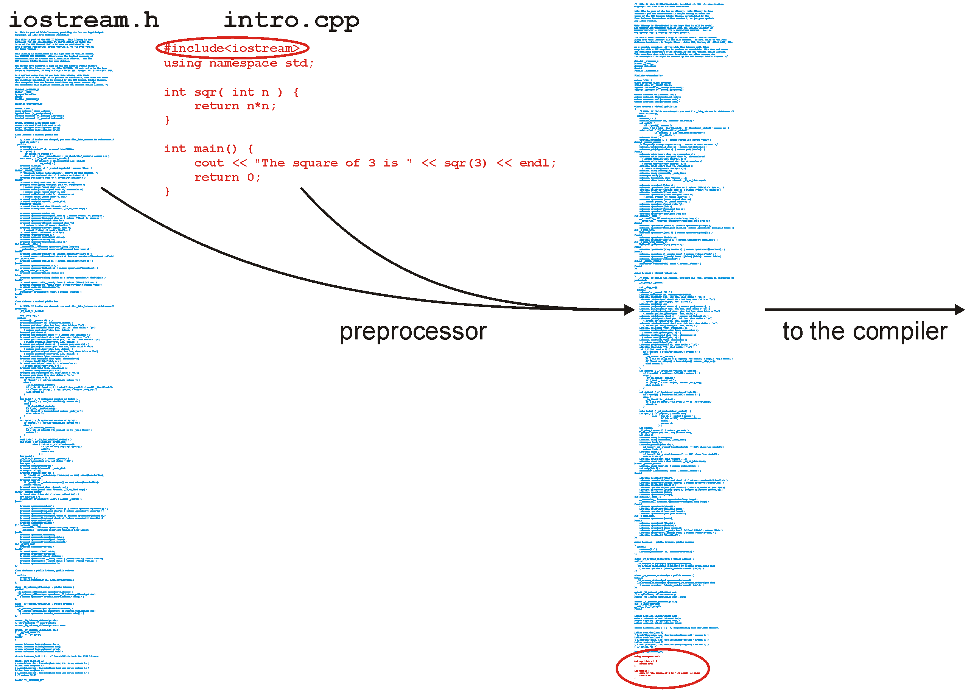
The C++ Preprocessor

Slide 10

What is the Problem of Preprocessor?
The more headers you include, the longer the compile time …
Notes:
To sum up, we have presented taskflow as a general-purpose parallel tasking tool. It introduces a simple, efficient, and transparent tasking model for C++ developers to quickly write parallel programs using minimal programming effort. We also talked about the general idea about our heterogeneous work-stealing executor and demonstrated its promising performance in large-scale ML and VLSI CAD workloads.
There are many excellent efforts from the C++ community on parallelism. Taskflow is not to replace anyone but to complement the current state of the art and address their limitations on the task graph parallelism by leveraging the power of modern C++.
We are very open to collaboration. We believe collaborative effort is the only way to make C++ amenable to parallel computing. Right now, we are based on cuda for GPU tasking, but we definitely want to integrate OpenCL, SYCL, DPC++, and so on. We want to provide more higher level algorithms on top of our task graph, like the thrust library, so developers can easily describe common parallel applications.
If you ever used Taskflow, please let us know, and we want to learn from you and broaden real use cases.

Slide 11
Libraries
You will write your code in a file such as Single_list.h where you will implement a data structure
This file will be included in our tester file Single_list_tester.h with a statement such as:
#include "Single_list.h"
The file Single_list_int_driver.cpp then includes the tester file:
#include "Single_list_tester.h"

Slide 12
Libraries
You will note the difference:
#include <iostream>
#include "Single_list.h"
The first looks for a file iostream.h which is shipped with the compiler (the standard library)
The second looks in the current directory
Notes:
12

Slide 13
Libraries
In this class, you will put all code in the header file
This is not normal practice:
Usually the header (.h) file only contains declarations
The definitions (the actual implementations) are stored in a related file and compiled into an object file
Notes:
13

Slide 14
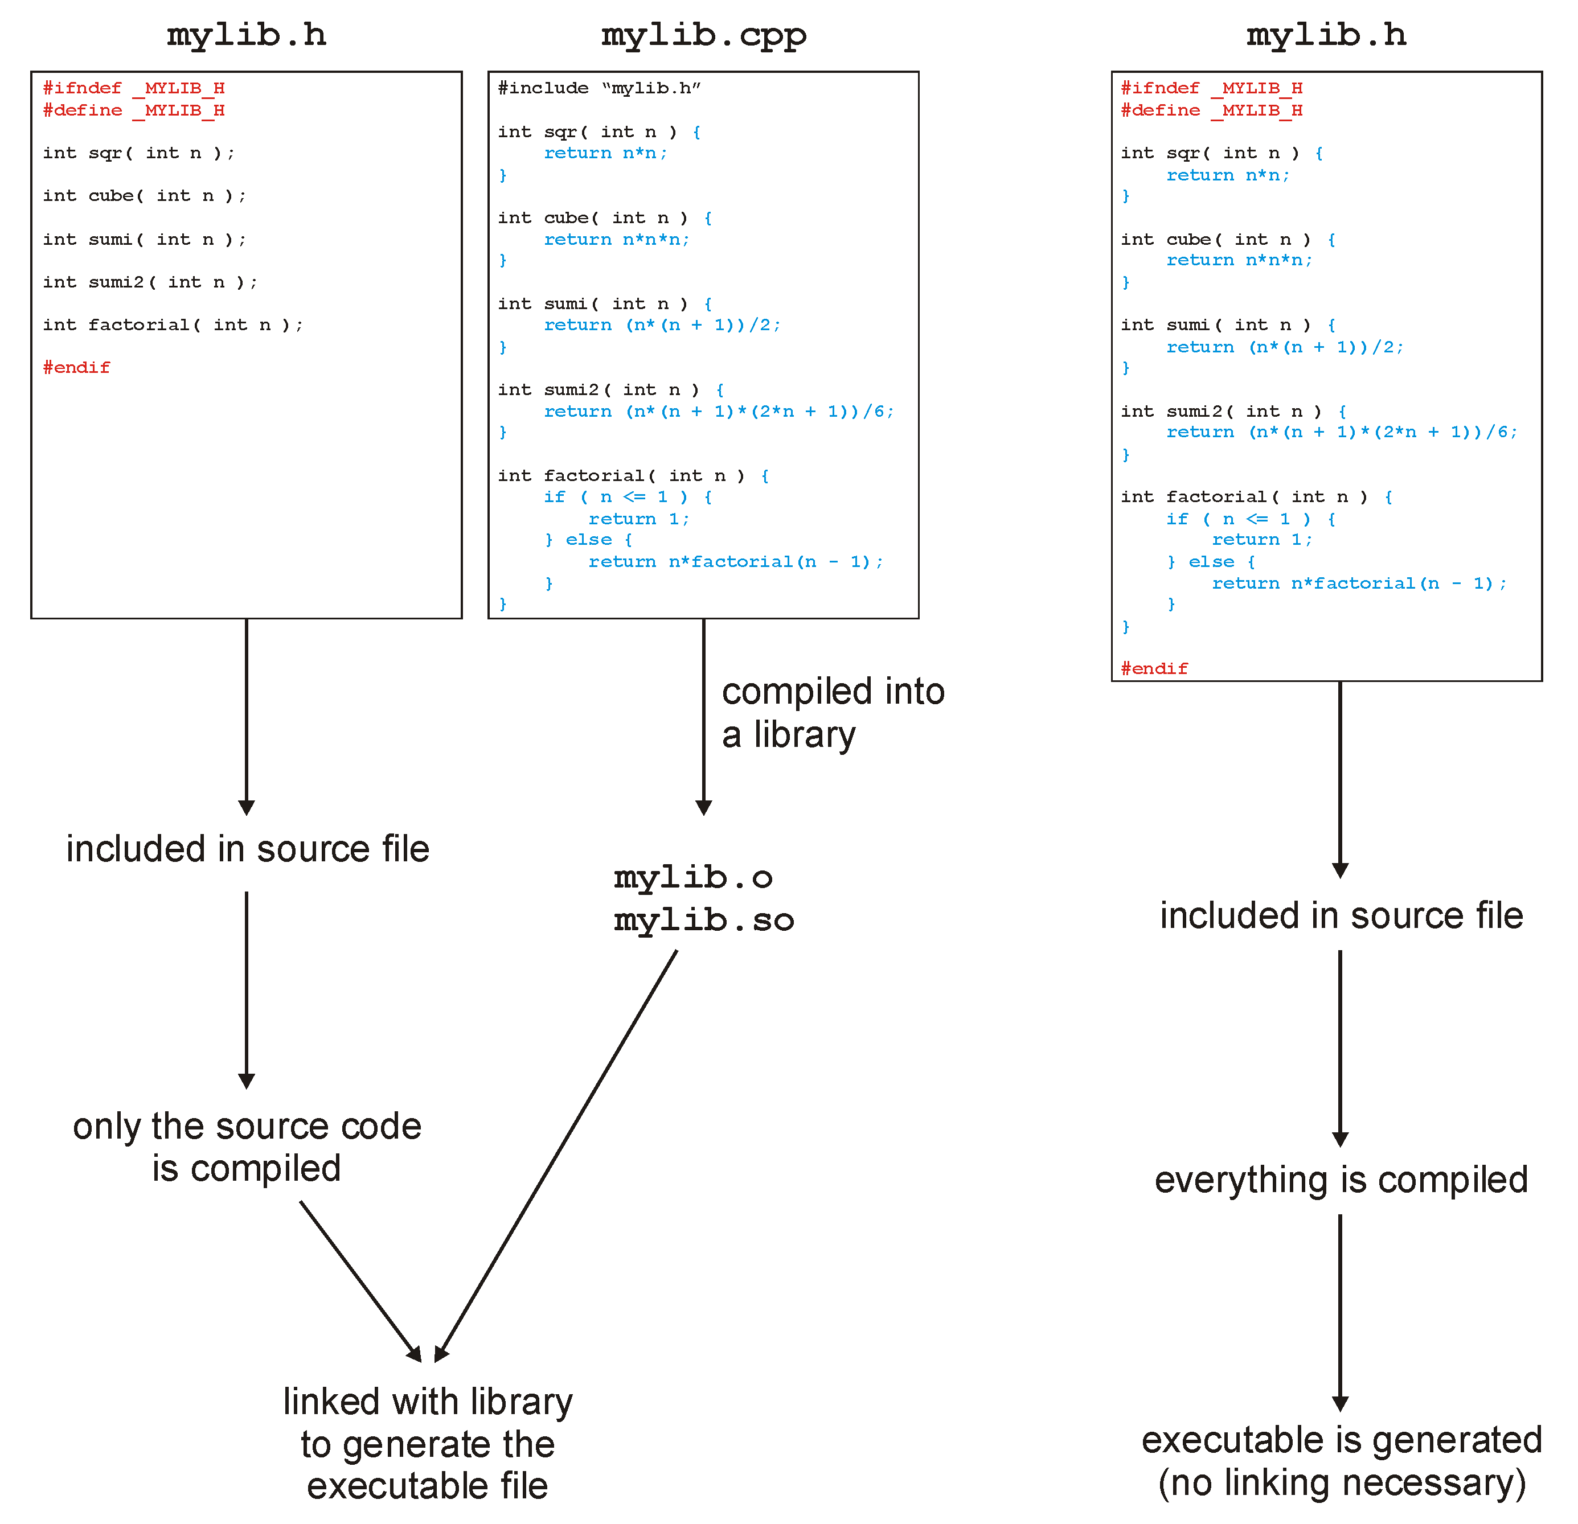
The C++ Preprocessor

Slide 15
The C++ Preprocessor
With all these includes, it is always necessary to avoid the same file being included twice, otherwise you have duplicate definitions
This is done with guard statements:
#ifndef SINGLE_LIST_H
#define SINGLE_LIST_H
template <typename Type>
class Single_list {
///...
};
#endif
Notes:
15

Slide 16
The C++ Preprocessor
This class definition contains only the signatures (or prototypes) of the operations
The actual member function definitions may be defined elsewhere, either in:
The same file, or
Another file which is compiled into an object file
We will use the first method

Slide 17
The File as the Unit of Compilation
Another difference is the unit of compilation
In C#, the class was the basis of compiling executable code:
class TestProgram {
public static void Main() {
System.Console.WriteLine( "Hello World" );
}
}
The existence of a function with the signature
public static void Main();
determines whether or not a class can be compiled into an executable

Slide 18
The File as the Unit of Compilation
In C/C++, the file is the base unit of compilation:
Any .cpp file may be compiled into object code
Only files containing an int main() function can be compiled into an executable
The signature of main is:
int main () {
// does some stuff
return 0;
}
The operating system is expecting a return value
Usually 0

Slide 19
The File as the Unit of Compilation
This file (example.cpp) contains two functions
#include<iostream>
using namespace std;
int sqr( int n ) { // Function declaration and definition
return n*n;
}
int main() {
cout << "The square of 3 is " << sqr(3) << endl;
return 0;
}

Slide 20
The File as the Unit of Compilation
To compile this file, we execute on the command line:
{ecelinux:1} g++ example.cpp
{ecelinux:2} ls
a.out example.cpp
{ecelinux:3} ./a.out
The square of 3 is 9
{ecelinux:4}

Slide 21
The File as the Unit of Compilation
This is an alternate form:
#include<iostream>
using namespace std;
int sqr( int ); // Function declaration
int main() {
cout << "The square of 3 is " << sqr(3) << endl;
return 0;
}
int sqr( int n ) { // Function definition
return n*n; // The definition can be in another file
}

Slide 22
Namespaces
Variables defined:
In functions are local variables
In classes are member variables
Elsewhere are global variables
Functions defined:
In classes are member functions
Elsewhere are global functions
In all these cases, the keyword static can modify the scope

Slide 23
Namespaces
Global variables/variables cause problems, especially in large projects
Hundreds of employees
Dozens of projects
Everyone wanting a function init()
In C++ (and XML), this is solved using namespaces

Slide 24
Namespaces
A namespace adds an extra disambiguation between similar names
namespace ca_uwaterloo_dwharder {
int n = 4;
double mean = 2.34567;
void init() {
// Does something...
}
}
There are two means of accessing these global variables and functions outside of this namespace:
The namespace as a prefix: ca_uwaterloo_dwharder::init()
The using statement:
using namespace ca_uwaterloo_dwharder;

Slide 25
Namespaces
You will only need this for the standard name space
All variables and functions in the standard library are in the std namespace
#include <iostream>
std::cout << "Hello world!" << std::endl;
#include <iostream>
using namespace std; // never used in production code
cout << "Hello world!" << endl;

Slide 26
Printing
Printing in C++ is done through overloading the << operator:
cout << 3;
If the left-hand argument of << is an object of type ostream (output stream) and the right-hand argument is a double, int, string, etc., an appropriate function which prints the object is called

Slide 27
Printing
The format is suggestive of what is happening:
The objects are being sent to the cout (console output) object to be printed
cout << "The square of 3 is " << sqr(3) << endl;
The objects being printed are:
a string
an int
a platform-independent end-of-line identifier

Slide 28
Printing
How does
cout << "The square of 3 is " << sqr(3) << endl;
work?
This is equivalent to
((cout << "The square of 3 is ") << sqr(3)) << endl;
where << is an operation (like +) which prints the object and returns the cout object

Slide 29
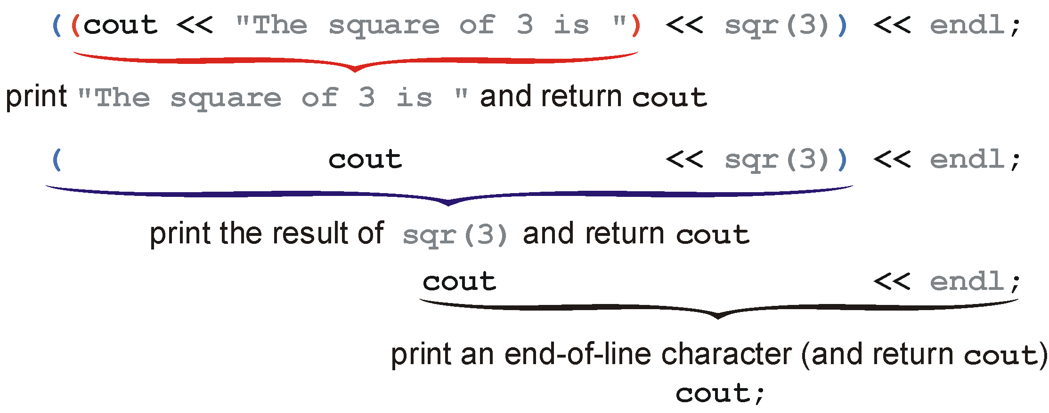
Printing
Visually:

Slide 30
Printing
Another way to look at this is that
cout << "The square of 3 is " << sqr(3) << endl;
is the same as:
operator<<( operator<<( operator<<( cout, "The square of 3 is " ), sqr(3) ), endl );
This is how C++ treats these anyway...

Slide 31
Introduction to C++
The next five topics in C++ will be:
Classes
Templates
Pointers
Memory allocation
Operator overloading
With these, you will have (more than) enough information to start Project 1
Project 1 is simply the implementation of a few variations of linked lists (from ECE 150)

Slide 32
Classes
To begin, we will create a complex number class
To describe this class, we could use the following words:
Store the real and imaginary components
Allow the user to:
Create a complex number
Retrieve the real and imaginary parts
Find the absolute value and the exponential value
Normalize a non-zero complex number

Slide 33
Classes
An example of a C++ class declaration is:
class Complex {
private:
double re, im;
public:
Complex( double = 0.0, double = 0.0 );
double real() const;
double imag() const;
double abs() const;
Complex exp() const;
void normalize();
};

Slide 34
Classes
This only declares the class structure
It does not provide an implementation
We could, like C#, include the implementation in the class declaration, however, this is not, for numerous reasons, standard practice

Slide 35
The Complex Class
The next slide gives both the declaration of the Complex class as well as the associated definitions
The assumption is that this is within a single file

Slide 36
The Complex Class
#ifndef _COMPLEX_H
#define _COMPLEX_H
#include <cmath>
class Complex {
private:
double re, im;
public:
Complex( double = 0.0, double = 0.0 );
// Accessors
double real() const;
double imag() const;
double abs() const;
Complex exp() const;
// Mutators
void normalize();
};

Slide 37
The Complex Class
Associates functions back to the class
// Constructor
Complex::Complex( double r, double i ):
re( r ),
im( i ) {
// empty constructor
}
Each member variable should be assigned
The order must be the same as the order in which the member variables are defined in the class
For built-in datatypes, this is a simple assignment.
For member variables that are objects, this is a call to a constructor.
For built-in datatypes, the above is equivalent to:
// Constructor
Complex::Complex( double r, double i ):re( 0 ), im( 0 ) {
re = r;
im = i;
}

Slide 38
The Complex Class
// Return the exponential of the complex value
Complex Complex::exp() const {
double exp_re = std::exp( re );
return Complex( exp_re*std::cos(im), exp_re*std::sin(im) );
}

Slide 39
The Complex Class
// Normalize the complex number (giving it unit absolute value, |z| = 1)
void Complex::normalize() {
if ( re == 0 && im == 0 ) {
return;
}
double absval = abs();
re /= absval;
im /= absval;
}
#endif
This calls the member function double abs() const from the Complex class on the object on which
void normalize() was called

Slide 40
Visibility
Visibility in C# and Java is described by placing public/private/protected in front of each class member or member function
In C++, this is described by a block prefixed by one of
private:
protected:
public:

Slide 41
Visibility
class Complex {
private:
double re, im;
public:
Complex( double, double );
double real() const;
double imag() const;
double abs() const;
Complex exp() const;
void normalize();
};

Slide 42
Visibility
The reason for the change in Java/C# was that the C++ version has been noted to be a source of errors
Code could be cut-and-paste from one location to another, and a poorly placed paste could change the visibility of some code:
public → private automatically caught
private → public difficult to catch and dangerous

Slide 43
Visibility
It is possible for a class to indicate that another class is allowed to access its private members
If class ClassX declares class ClassY to be a friend, then class ClassY can access (and modify) the private members of ClassX

Slide 44
Visibility
class ClassY; // declare that ClassY is a class
class ClassX {
private:
int privy; // the variable privy is private
friend class ClassY; // ClassY is a "friend" of ClassX
};
class ClassY { // define ClassY
private:
ClassX value; // Y stores one instance of X
public:
void set_x() {
value.privy = 42; // a member function of ClassY can
} // access and modify the private
}; // member privy of "value"

Slide 45
Accessors and Mutators
We can classify member functions into two categories:
Those leaving the object unchanged
Those modifying the member variables of the object
Respectively, these are referred to as:
Accessors: we are accessing and using the class members
Mutators: we are changing—mutating—the class members

Slide 46
Accessors and Mutators
Good programming practice is to enforce that a routine specified to be an accessor cannot be accidentally changed to a mutator
This is done with the const keyword after the parameter list
double abs() const;

Slide 47
Accessors and Mutators
If a junior programmer were to try change
double Complex::abs() const {
return std::sqrt( re*re + im*im );
}
to
double Complex::abs() const {
re = 1.0; // modifying (mutating) 're'
return std::sqrt( re*re + im*im );
}
the compiler would signal an error

Slide 48
Accessors and Mutators
As an example from a previous project, a student did this:
template <typename Type>
int Double_sentinel_list<Type>::count( Type const &obj ) const {
for ( Double_node<Type> *temp = head(); temp != nullptr; temp = temp->next() ) {
if ( temp->retrieve() == obj ) {
++list_size;
}
}
return list_size;
}
Here, list_size was a member variable of the class
This code did not compile: the compiler issued a warning that a member variable was being modified in a read-only member function

Slide 49
Accessors and Mutators
What the student wanted was a local variable:
template <typename Type>
int Double_sentinel_list<Type>::count( Type const &obj ) const {
int obj_count = 0;
for ( Double_node<Type> *temp = head(); temp != nullptr; temp = temp->next() ) {
if ( temp->retrieve() == obj ) {
++obj_count;
}
}
return obj_count;
}

Slide 50
Templates
Now that we have seen an introduction to classes, the next generalization is templates

Slide 51
Templates
In Java you will recall that all classes descend from the Object class
Thus, it is possible to create an array which can hold instances of any class:
Object [] array = new Object[10];

Slide 52
Templates
Suppose you want to build a general linked list which could hold anything
In Java you could have it store instance of the class Object
Because there is no ultimate Object class, to avoid re-implementing each class for each class we are interested in storing, we must have a different mechanism

Slide 53
Templates
This mechanism uses a tool called templates
A function has parameters which are of a specific type
A template is like a function, however, the parameters themselves are types

Slide 54
Templates
That mechanism is called a template:
template <typename Type>
Type sqr( Type x ) {
return x*x;
}
This creates a function which returns something of the same type as the argument

Slide 55
Templates
To tell the compiler what that type is, we must suffix the function:
int n = sqr<int>( 3 );
double x = sqr<double>( 3.141592653589793 );
Usually, the compiler can determine the appropriate template without it being explicitly stated

Slide 56
Templates
Example:
#include<iostream>
using namespace std;
template <typename Type>
Type sqr( Type x ) {
return x*x;
}
int main() {
cout << "3 squared is " << sqr<int>( 3 ) << endl;
cout << "Pi squared is " << sqr<double>( 3.141592653589793 ) << endl;
return 0;
}
Output:
3 squared is 9
Pi squared is 9.8696

Slide 57
Templates
Thus, calling sqr<int>( 3 ) is equivalent to calling a function defined as:
int sqr( int x ) {
return x*x;
}
The compiler replaces the symbol Type with int
template <typename Type>
Type sqr( Type x ) {
return x*x;
}

Slide 58
Templates
Our complex number class uses double-precision floating-point numbers
What if we don’t require the precision and want to save memory with floating-point numbers
Do we write the entire class twice?
How about templates?

Slide 59
Templates
#ifndef _COMPLEX_H
#define _COMPLEX_H
#include <cmath>
template <typename Type>
class Complex {
private:
Type re, im;
public:
Complex( Type const & = Type(), Type const & = Type() );
// Accessors
Type real() const;
Type imag() const;
Type abs() const;
Complex exp() const;
// Mutators
void normalize();
};

Slide 60
Templates
The modifier template <typename Type> applies only to the following statement, so each time we define a function, we must restate that Type is a templated symbol:
// Constructor
template <typename Type>
Complex<Type>::Complex( Type const &r, Type const &i ):re(r), im(i) {
// empty constructor
}

Slide 61
Templates
// return the real component
template <typename Type>
Type Complex<Type>::real() const {
return re;
}
// return the imaginary component
template <typename Type>
Type Complex<Type>::imag() const {
return im;
}
// return the absolute value
template <typename Type>
Type Complex<Type>::abs() const {
return std::sqrt( re*re + im*im );
}

Slide 62
Templates
// Return the exponential of the complex value
template <typename Type>
Complex<Type> Complex<Type>::exp() const {
Type exp_re = std::exp( re );
return Complex<Type>( exp_re*std::cos(im), exp_re*std::sin(im) );
}
// Normalize the complex number (giving it unit norm, |z| = 1)
template <typename Type>
void Complex<Type>:noramlize() {
if ( re == 0 && im == 0 ) {
return;
}
Type absval = abs();
re /= absval;
im /= absval;
}
#endif

Slide 63
Templates
Example:
#include <iostream>
#include "Complex.h"
using namespace std;
int main() {
Complex<double> z( 3.7, 4.2 );
Complex<float> w( 3.7, 4.2 );
cout.precision( 20 ); // Print up to 20 digits
cout << "|z| = " << z.abs() << endl;
cout << "|w| = " << w.abs() << endl;
z.normalize();
w.normalize();
cout << "After normalization, |z| = " << z.abs() << endl;
cout << "After normalization, |w| = " << w.abs() << endl;
return 0;
}
Ouptut:
|z| = 5.5973207876626123181
|w| = 5.597320556640625
After normalization, |z| = 1.0000000412736744781
After normalization, |w| = 1

Slide 64
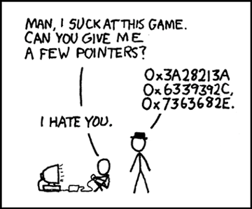
Pointers
One of the simplest ideas in C, but one which most students have a problem with is a pointer
Every variable (barring optimization) is stored somewhere in memory
That address is an integer, so why can’t we store an address in a variable?

Slide 65
Pointers
We could simply have an ‘address’ type:
address ptr; // store an address
// THIS IS WRONG
However, the compiler does not know what it is an address of (is it the address of an int, a double, etc.)
Instead, we have to indicate what it is pointing to:
int *ptr; // a pointer to an integer
// the address of the integer variable 'ptr'

Slide 66
Pointers
First we must get the address of a variable
This is done with the & operator (ampersand/address of)
For example,
int m = 5; // m is an int storing 5
int *ptr; // a pointer to an int
ptr = &m; // assign to ptr the
// address of m

Slide 67
Pointers
We can even print the addresses:
int m = 5; // m is an int storing 5
int *ptr; // a pointer to an int
ptr = &m; // assign to ptr the
// address of m
cout << ptr << endl;
prints 0xffffd352, a 32-bit number
The computer uses 32-bit addresses

Slide 68
Pointers
We have pointers: we would now like to manipulate what is stored at that address
We can access/modify what is stored at that memory location by using the * operator (dereference)
int m = 5;
int *ptr;
ptr = &m;
cout << *ptr << endl; // prints 5

Slide 69

Pointers
Similarly, we can modify values stored at an address:
int m = 5;
int *ptr;
ptr = &m;
*ptr = 3; // store 3 at that memory location
cout << m << endl; // prints 3

Slide 70
Pointers
Pointers to objects must, similarly be dereferenced:
Complex z( 3, 4 );
Complex *pz;
pz = &z;
cout << z.abs() << endl;
cout << (*pz).abs() << endl;

Slide 71
Pointers
One short hand for this is to replace
(*pz).abs();
with
pz->abs();

Slide 72
Memory Allocation
Memory allocation in C++ and C# is done through the new operator
This is an explicit request to the operating system for memory
This is a very expensive operation
The OS must:
Find the appropriate amount of memory,
Indicate that it has been allocated, and
Return the address of the first memory location

Slide 73
Memory Allocation
Memory deallocation differs, however:
C# uses automatic garbage collection
C++ requires the user to explicitly deallocate memory
Note however, that:
managed C++ has garbage collection
other tools are also available for C++ to perform automatic garbage collection

Slide 74
Memory Allocation
Inside a function, memory allocation of declared variables is dealt with by the compiler
int my_func() {
Complex<double> z(3, 4); // calls constructor with 3, 4
// creates 3 + 4j
// 16 bytes are allocated by the compiler
double r = z.abs(); // 8 bytes are allocated by the compiler
return 0; // The compiler reclaims the 24 bytes
}

Slide 75
Memory Allocation
Memory for a single instance of a class (one object) is allocated using the new operator, e.g.,
Complex<double> *pz = new Complex<double>( 3, 4 );
The new operator returns the address of the first byte of the memory allocated

Slide 76
Memory Allocation
We can even print the address to the screen
If we were to execute
cout << "The address pz is " << pz << endl;
we would see output like:
The address pz is 0x00ef3b40

Slide 77
Memory Allocation
Next, to deallocate the memory (once we’re finished with it) we must explicitly tell the operating system using the delete operator:
delete pz;

Slide 78
Memory Allocation
Consider a linked list where each node is allocated:
new Node<Type>( obj )
Such a call will be made each time a new element is added to the linked list
For each new, there must be a corresponding delete:
Each removal of an object requires a call to delete
If a non-empty list is itself being deleted, the destructor must call delete on all remaining nodes

Slide 79
A Quick Introduction to C++
To summarize:
we have seen some of the similarities and differences between C# and C++
these slides touch on all of the topics which you will need to know to implement all of your projects

Slide 80
A Quick Introduction to C++
There is a full C++ course this semester on CS 1420 starting from scratch
The tutorial does not even assume you know what a variable is
There are exercises and example code which you can run yourself

